Slide 1
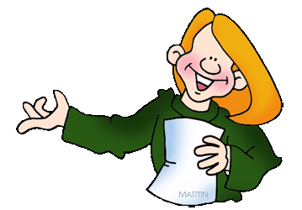
Small Talk - Greetings & Describing People

Slide 2
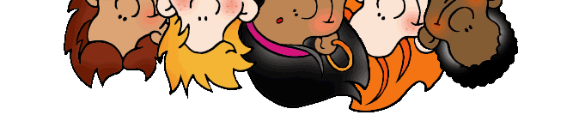
The Right Greeting for Every Situation in English
“When greeting someone in English, it’s important to use the right level of formality for each situation. And that’s exactly what I’ll help you learn in this lesson.”

Slide 3
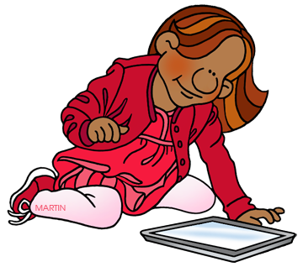
English Greetings for Professional/Formal Situations
Situations in which we may need more formal or business professional language in English. Some common examples include:
Business meetings & negotiations
At a job interview
Communicating with high-level management
Saying hello to the company president or CEO
Showing respect to elderly individuals or people we do not know well
Meeting new business colleagues
Communicating with new clients, high-level clients, angry clients

Slide 4
Formal Greetings
Good morning / Good afternoon / Good Evening
This is the most common form of greeting in a formal situation and is appropriate to use anytime – with colleagues, business clients, formal relationships, new neighbors, etc.
To be particularly respectful, you can also include the person’s last name, for example:
“Good morning, Ms Jones.” If you know someone well, you can also use the first name.
When you are greeting a group of people – for example at a meeting – you can also say something such as:
Good morning, everyone. I hope you are doing well this morning.
Hello. How do you do?
This is used when meeting someone for the first time and is very formal.
It may be used in a formal business situation or a formal dinner party event.
Be careful. This is not really a “How are you?” question. It is really
a simple greeting and has a similar meaning to “Nice to meet you.”

Slide 5
Formal Greetings
Nice to meet you. / Pleased to meet you.
You are probably already familiar with these expressions from your English studies as they are common in many English books. These expressions are best used in formal or business situations when you meet someone for the first time, for example,
A: “Good morning. How do you do? I’m John Doe.”
B: “Pleased to meet you Mr. Rammas.”
How have you been doing? / How have you been?
This is a very simple, polite and appropriate question to use to start a conversation in a business or formal situation. It is a respectful way to ask “How are you?” with someone you have not seen in a long time or someone you do not see every day.

Slide 6
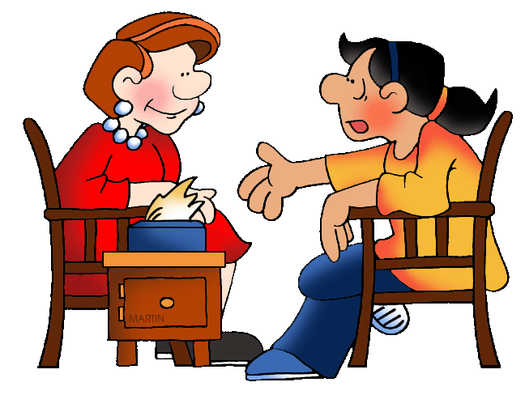
Play the part
Greetings Practice
Gather in teams of two
Listen to the following dialogs on this link:
Select the dialog to play the part (A or B) and … let’s talk!!!!.
https://www.eslfast.com/robot/topics/smalltalk/smalltalk01.htm

Slide 7
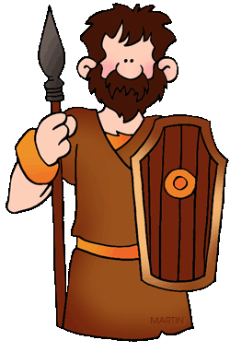
Describing People Vocabulary
HEIGHT / WEIGHT
obese
fat
slightly overweight
well-built
heavily built
of average build
slightly built
slim
thin / skinny / bony
tall
of medium height
shortish
short / tiny
FACE / HAIR
round / oval / square / heart shaped face
bushy / thick / thin eyebrows
round / almond / narrow / close-set eyes
broad / flat / sharp / button / fake nose
full / thin / well-defined lips
broad smile / charming smile
healthy / damaged teeth / (tooth) braces
wrinkles / freckles / pimples / smooth skin
moustache / beard
thick / rich / strong / healthy / shiny hair
damaged hair / split ends
thin hair / receding hair
straight / wavy / curly hair
spiky hair
fringe
permed hair
coloured / dyed hair
bleached hair / highlights
pigtails / ponytail / braids / bun / dreads
pull your hair back/put your hair up (with a clip or an elastic band)
long / short / shoulder-length

Slide 8
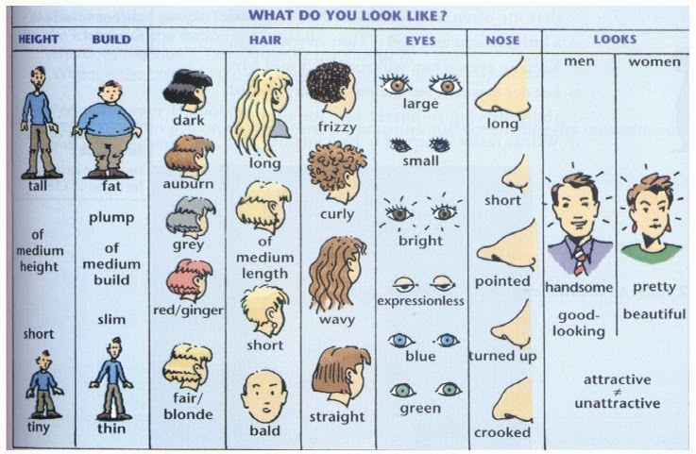
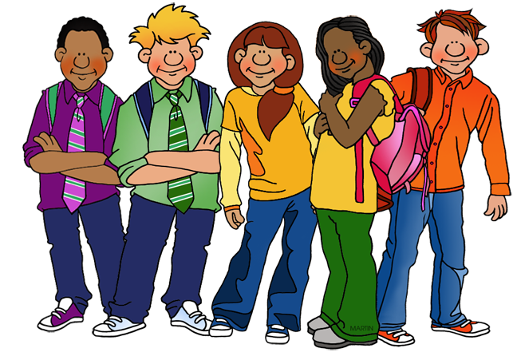
Adjectives to describe people
https://www.clarkandmiller.com/72-appearance-adjectives-you-need-to-describe-people-in-english

